Slide 1


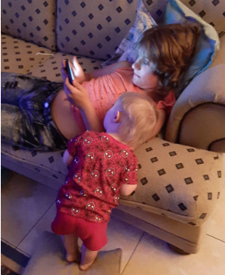




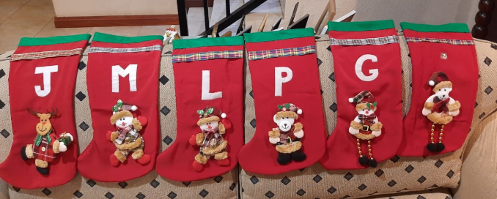
Merry Christmas – 2020

Slide 2

Merry Christmas 2020

Slide 3
_dataStorage
RFQHEAD
RFQREQITEMS
RFQRESITEMS
RFFQRESPHEAD
GUID
EMAIL
Ref_Text
RFQNo
Cut-off
Delivery Date
Request_Text
GUID
EMAIL
RFQGUID
ITEMNO
Material
Short_Text
Long_Text
Quantity
GUID
EMAIL
RFQGUID
ITEMNO
Price
Long_Text
Del_Horizon
GUID
EMAIL
RFQGUID
Long_Text
Acceptance
Response_Date
RFQ List
Model-Service
RFQHeader
Information
Vendor
Cut-off dates
Info-Documents
Request Texts
Item Texts
Update
Pricing (item-KEYS)
Response-Texts(item-TAGS)
Response-Documents
Control-Dates (item-DATA)
Index keys
Guid-Obj-Sub_Context
GUID-EMAIL-RFQGUID
RfqInfo
Docs
Response
RfqResp
Docs
Keys
Documents
Response Text
Documents
RFQItems and tenderItems
Rfq-Item
Item
Texts
Pricing

Slide 4
Data Structure of RFQ Solution
ZIO_RFQUOTE
export class BIDCONTROL{
RELEASE_DATE: string;
VIEWED_ON: string;
RESPONDED_ON: string;
EMAIL_LINK: string;
ADDEDBY: string;
ADDEDON: string;
VALIDITY: number;
ACCEPTANCE: string;}
ZRFC_OBJ Headerline(Tender)
ZRFC_OBJ Vendorline(Bid)
export class RfcObj {
MANDT: string;
GUID: string;
OBJ: string; SUBMI or REFNO
OBJ_TYPE: string; RFQUOTE
CONTEXT: string; Short Text Description
SUB_CONTEXT: string; Object type e.g. RFQ
CREATED: number;
DATA: string; Control Dates
DATA_TYPE: string; STATUS
MODIFIED: number;
DATA_MD5: string;
TAGS: string; Request Long text
KEYS: string; Tender ITEMS
}
export class RfcObj {
MANDT: string;
GUID: string;
OBJ: string; Email
OBJ_TYPE: string; Vendor No
CONTEXT: string; Unique Token
SUB_CONTEXT: string; REFNO
CREATED: number;
DATA: string; Control & Dates
DATA_TYPE: string; Short Text Description
MODIFIED: number;
DATA_MD5: string;
TAGS: string; Response Long Text
KEYS: string; Bid ItemsResponse
}
ZWEB_BID_ITEM
export interface BidItem {
itemno: string;
assumption?: string;
bidprice?: number;
leadtime?: string;
validity?: string;
biddate?: string;
}
ZWEB_TENDER_ITEM
ZRFQ_CONTROL
On WEB-Only
export class TENDERITEM {
ITEMNO: string;
MATERIAL: string;
MTEXT: string;
QUANTITY: number;
UOM: string;
MLONGTEXT: string;
DELIVERYDATE: number;
VALIDITY: string;}
export class CONTROL_DATES {
CREATED: string;
STARTDATE: string;
CUTOFFDATE: string;
CUTOFFTIME: string;
RELEASED: string;
CREATEDBY: string;
RELEASEDBY: string;
CONTACTMAIL: string;
CONTACTTEL: string;
CONTACTNAME: string;
DELIVERYDATE: string;
CLOSED: string;
CLOSEDBY: string;
VALIDITY?: string ;
}
export interface Tender
1 guid: HEADER-GUID;
2 email: BID-OBJ;
3 bidGuid: BID-CONTEXT;
4 rfqNo?: BID-SUB_CONTEXT;
5 refText?: BID-DATA_TYPE;
6 reqText?: HEADER_TEXT ;
7 cutoff?: Header-DATA-> Control Dates ;
8 cutofftime?: Header-DATA-> Control Dates;
9 validity?: BID-DATA->Control;
10 contactEmail?: Header-DATA-> Control Dates;
11 contactTel?: Header-DATA-> Control Dates;
12 contactName?: Header-DATA-> Control Dates ;
13 infoItems?: Header-KEYS
14 bid?: BID-KEYS;
}
Merge?

Slide 5
Esourcing – list of open Tenders user is linked to
Select 1
Rfq
Display loading gif until loaded – go to header
Get Tender and Bid
And Docs linked
Upload Overall Assumption, Validity and Documents
Update item
Build Tender Object
Rfq-header
Show Information
Download Documents
Bid >>
Rfq-items – list of Tender items
Accept Bid
Overall Validity
Overall Assumption
Upload Documents
Rfq-item-detail – Fill in
Price,
Validity and
Assumptions
Select 1

Slide 6
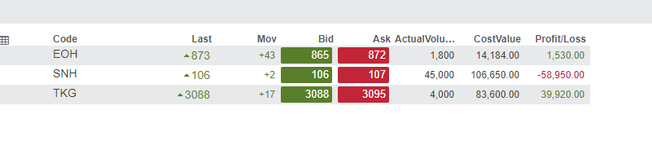

Slide 7
RFQHeader
Merge to Tender
Extract ResponseText
Edit ResponseText
RFQVendor
Merge to TenderItem[]
Keys & Keys
Change to Bid Response: text,
Items: BidItem[]
Extract to BidItem
Edit Bid Item
RFQHEAD
Update Bid
Update TenderItem[]
Update SAP
Update Control
GUID
EMAIL
Ref_Text
RFQNo
Cut-off
Delivery Date
Request_Text
BidPriceResponse
BidResponse
guid: string;
email: string;
bidGuid: string;
itemindex: string;
assumption: string;
bidprice: number;
horizon: string;
quality: string;
lastdate: string;
guid: string;
email: string;
bidGuid: string;
longtext: string;
quality: string;
lastdate: string;
RFQREQITEMS
GUID
EMAIL
RFQGUID
ITEMNO
Material
Short_Text
Long_Text
Quantity

Slide 8
Check if more than 1 RFQ for EMAIL
>1
No –> go to RFQ
Information, Documents , Printed Version
Comment
List of RFQ’s for Selection
BidPriceResponse
BidResponse
guid: string;
email: string;
bidGuid: string;
itemindex: string;
assumption: string;
bidprice: number;
validity: string;
horizon: string;
quality: string;
lastdate: string;
guid: string;
email: string;
bidGuid: string;
longtext: string;
quality: string;
lastdate: string;
Request Material Text
Price
Price Validity
Availability
QA
Assumptions and Conditions

Slide 9
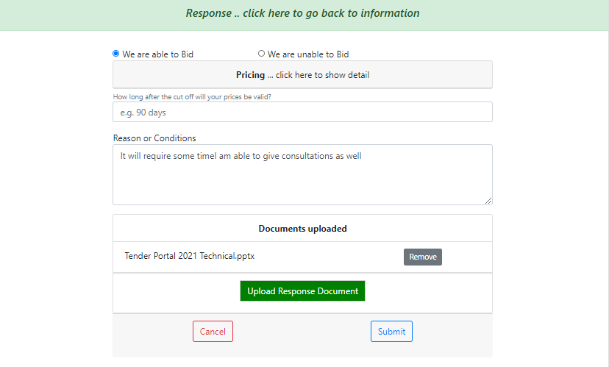
Bid.acceptance
Bid.items[]
Bid.validity
Bid.response

Slide 10
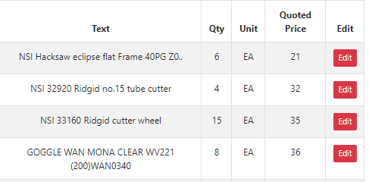
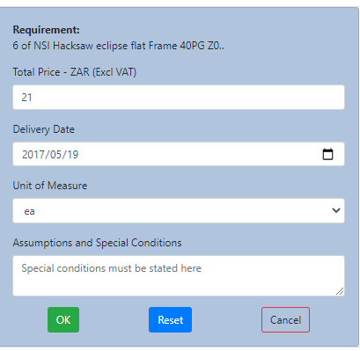
tenderItem.quantity
tenderItem.itemindex
Item 0010
..more
tenderItem.matText
tenderItem’longText
BidItem.bidprice
Lead time needed
Ex-Stock
BidItem.leadtime
Price Validity Period
90 Days
BidItem.validity
BidItemResponse
BidResponse
guid: string;
email: string;
bidGuid: string;
itemindex: string;
assumption: string;
bidprice: number;
validity: string;
leadtime: string;
lastdate: string;
guid: string;
email: string;
bidGuid: string;
longtext: string;
quality: string;
acceptance: string
lastdate: string;
BidItem.assumption

Slide 11
dd
dd
dd
dd
Angular
DME_API_V1
DME_API_V1
Mikethomson.biz
Mysql
Index.php
YII2
laravel

